Slide 1

Larry Cai larry.caiyu@gmail.com
Leo Luo leorowe.wei@gmail.com

Slide 2



Agenda
ELK Stack Introduction
Prerequisite: Setup environment using Docker
Exercise 1: Say Hello To ELK Stack
Exercise 2: Analyze Shakespeare works
Exercise 3: Customize your Kibana Dashboard
Exercise 4: Use customize grok rule to parse your "Hello World"
Exercise 5: Use pre-defined grok rule to filter Apache log
Learn ELK in Docker in 90 minutes

Slide 3
What is ELK stack
ElasticSearch
  Store the data that LogStash processed and provide full-text index
LogStash
  Collecting and parsing log files. Transform unstructured log into meaningful and searchable.
Kibana
  Provide a friendly web console for user to interact with ElasticSearch.
Learn ELK in Docker in 90 minutes

Slide 4
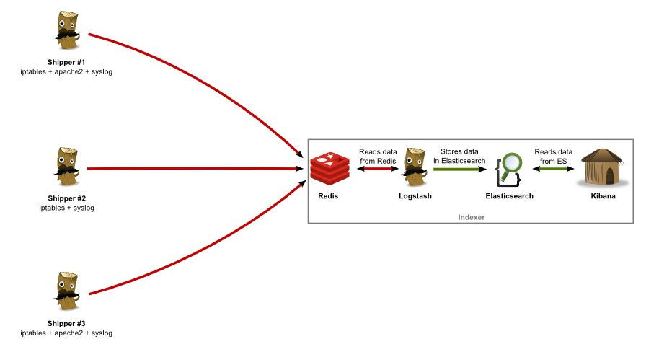
What is ELK stack – Deploy Diagram
Learn ELK in Docker in 90 minutes

Slide 5

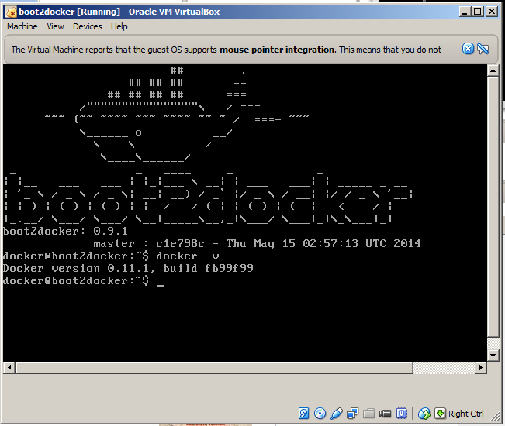
Environment (docker)
Boot2docker 1.3.x /recommend
  $ docker -v
  User/Passwd: docker/tcuser
Start the container
  docker pull leorowe/codingwithme-elk
  docker tag leorowe/codingwithme-elk elk
  docker run -d --name elk -p 80:80 -p 3333:3333 -p 9200:9200 elk
Enter the container
  docker exec -it elk bash
http://boot2docker.io/
Learn ELK in Docker in 90 minutes

Slide 6
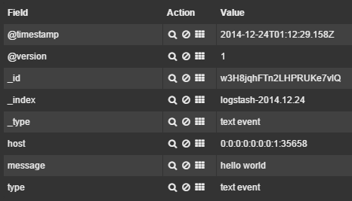
Exercise 1:
Say Hello To ELK Stack
Open the browser and visit Kibana (192.168.59.103 )
    If it return HTTP 404 then
    ifconfig (docker@boot2docker: and find eth1 ip, begin with 192.168.)
Say “Hello World” to ELK
  echo ‘Hello World’ | nc localhost 3333 (boot2Docker)
Check the greeting in Kibana
Learn ELK in Docker in 90 minutes

Slide 7
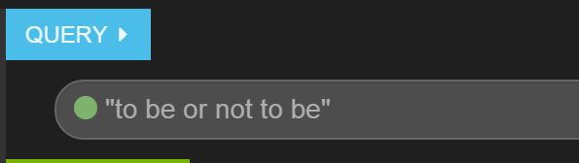
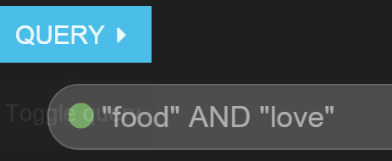
Exercise 2: Analyze Shakespeare works
Enter ELK container: docker exec –it elk bash
/build.sh
Find line_id of “to be or not to be”
How many times did “food” and “love” appear in the same sentence.
Learn ELK in Docker in 90 minutes

Slide 8
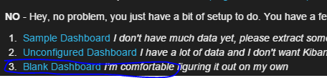

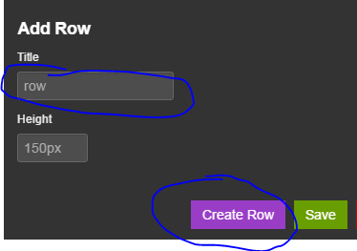
Exercise 3：Customize your Kibana Dashboard
Open a blank dashboard
Add a row
  1.click “Add A Row” button
  2.type the row name then click Create Row and Save button
Learn ELK in Docker in 90 minutes

Slide 9

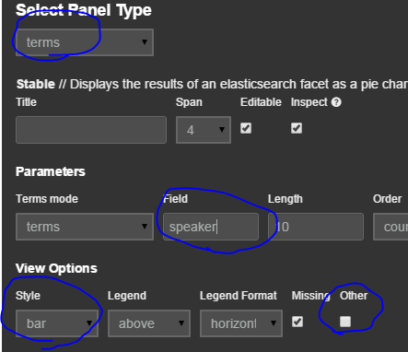
Add a terms panels
Click Add Panel button
Select terms as Panel Type
  Type speaker as Fileld
  Toggle Other checkbox
  Select bar as View Options Style
  Click Save button
Learn ELK in Docker in 90 minutes

Slide 10


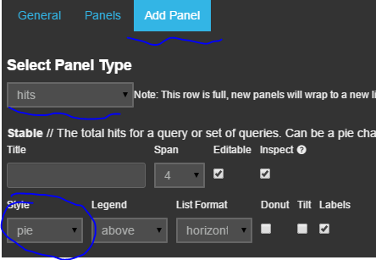
Men vs Women. Who wins?
Add a new query box
Type men and women in each query box
Click search button
Add a Hits Panel
  Choose hits as type
  Choose pie as Style
  Click Save button
Learn ELK in Docker in 90 minutes

Slide 11
Exercise 4：Use customize grok filter to parse your "Hello World"
add a grok filter into /logstash.conf
  input { tcp { port => 3333 type => "text event"}}
  filter{
  grok{ match=>['message','%{WORD:greetings}%{SPACE}%{WORD:name}']
  }
  }
  output { elasticsearch { host => localhost } }
Learn ELK in Docker in 90 minutes

Slide 12

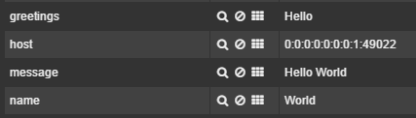
Restart logstash
Restart logstash (or /restart-logstash.sh)
  ps –ef | grep logstash (find the logstash pid)
  kill -9 <logstash pid>
  exec /logstash/bin/logstash agent -f /logstash.conf &
  echo ‘Hello <your name>’ | nc localhost 3333
  Check out Logstash Dashboard page
Learn ELK in Docker in 90 minutes

Slide 13
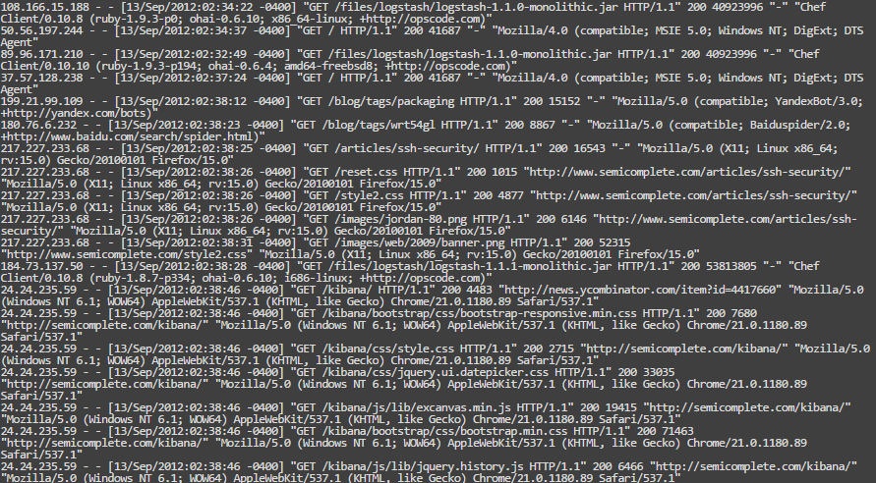
Exercise 5：Use Logstash to filter Apache log
Learn ELK in Docker in 90 minutes

Slide 14
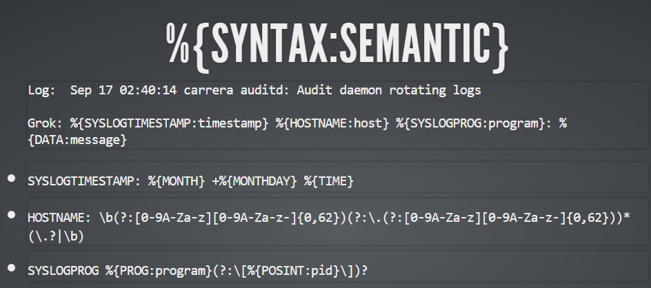
Exercise 5：Use Logstash to filter Apache log
Using grok
Learn ELK in Docker in 90 minutes

Slide 15
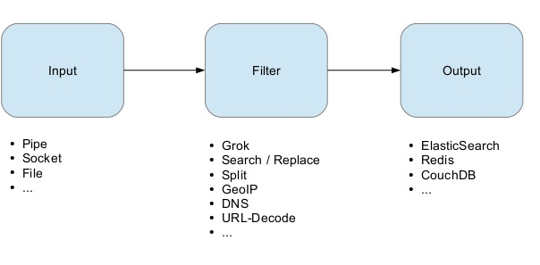
Workflow
See http://logstash.net/docs/1.4.2/tutorials/getting-started-with-logstash
Learn ELK in Docker in 90 minutes

Slide 16
Add a file input
input {
tcp { port => 3333 type => "text event"}
}
file {
type => 'apache-log'
path => '/*.log‘
start_position => "beginning"
}
}
Learn ELK in Docker in 90 minutes

Slide 17
Add a filter to deal with Apache logs
filter{
if [type]=='apache-log'{
grok{
match=>['message','%{COMMONAPACHELOG:message}']
}
date{
match=>['timestamp','dd/MMM/yyyy:HH:mm:ss Z']
}
mutate {
convert => { "response" => "integer" }
convert => { "bytes" => "integer" }
}
}
}
Learn ELK in Docker in 90 minutes

Slide 18
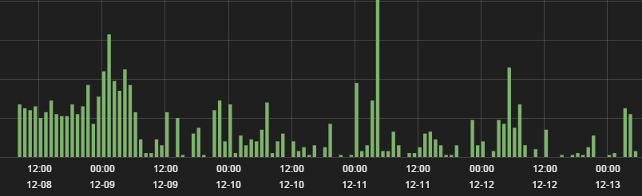
Exercise 5：Use Logstash to filter Apache log
Restart logstash (/restart-logstash.sh)
Check out Logstash Dashboard Page.
Learn ELK in Docker in 90 minutes

Slide 19
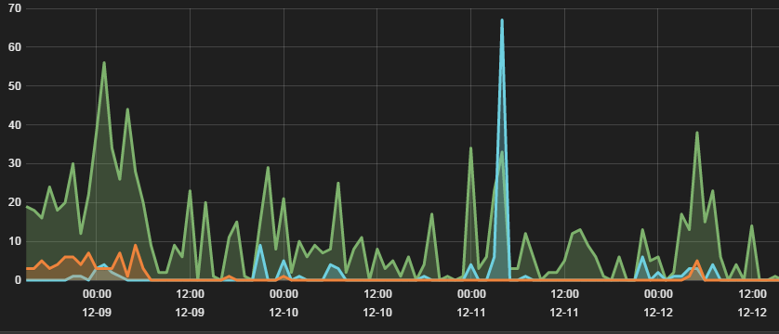
Exercise 5：Use Logstash to filter Apache log
Add response query
  response:200 response:304 response:401
Learn ELK in Docker in 90 minutes

Slide 20
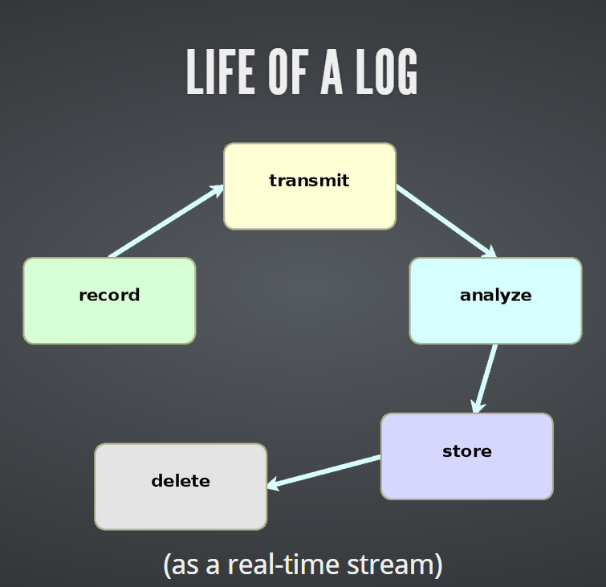
Summary
ELK Stack is the off the shelf toolkits to manage and analyze your logs or whatever it has a timestamp attribute.
Learn ELK in Docker in 90 minutes

Slide 21
Reference
http://www.elasticsearch.org/guide/
https://datapsyche.wordpress.com/2014/07/30/docker-app-tutorial-creating-a-docker-container-for-elk-elasticsearch-logstash-kibana/
Learn ELK in Docker in 90 minutes

